Slide 1
Meeting 22/10/2021

Slide 2
Workplan review
Don’t start writing too early on subjects that might not be used
Theory and practice should be equally detailed
Later on more literature study on detailed selected subjects
Live document with reviews (share the papers with slack)
Goal: prediction in continuous time t+dt2

Slide 3
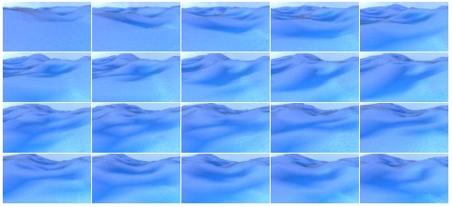
Blender data

